Slide 1

Select Topics in Python Creating and Using Tuples
Notes:
‹#›

Slide 2

Objectives
Objectives
Introduction to tuples in Python
Initialize tuples
Convert to tuples
Slice to tuples
Iterate through a list of tuples
Notes:
Unlike list data structure, a tuple is immutable. Hence, you cannot add, update or delete the elements of the tuple after creating it. However, if you want to perform any operations on the tuple, a separate copy of the same tuple is created, and then necessary modifications are made. Below example shows a tuple in python programming:
Tuples in Python are a data structure used to store multiple elements in a single variable. Just like list data structure, a tuple is homogenous. Therefore, a tuple can consist of elements of multiple data types at the same time. You can create a tuple by placing all elements inside the parentheses(()) separated by commas. Note that the parentheses are an option, however, it is always a good practice to use them while working with tuples in python.
‹#›

Slide 3
Introduction to Tuples
Tuples.
Data structure in Python.
Each value in the tuple is an element or item.
Elements can be any Python data type.
Tuples can mix data types.
Elements can be nested tuples.
yearBorn = (”Bob Hope", 1903)
tuple name
first element: a string
second element: an integer
In Python, a tuple is an immutable sequence of values.
Notes:
What does immutable mean?
Tuples are immutable which means you cannot update or change the values of tuple elements
‹#›

Slide 4
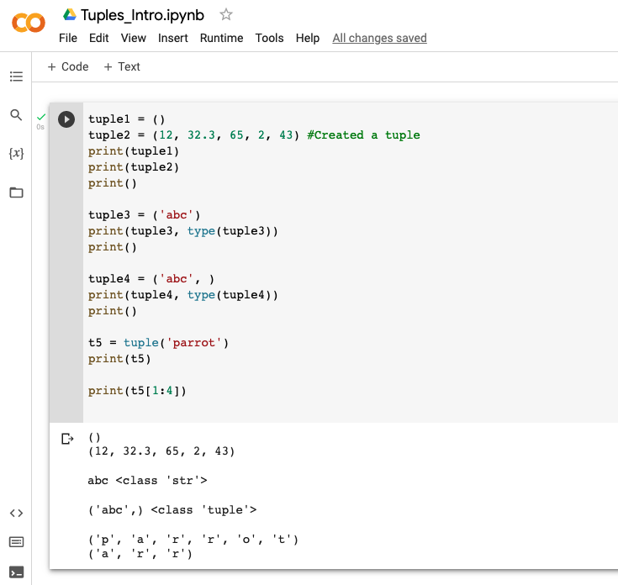
Initialize Tuples
Create a tuple
Empty set.
Lists.
Comparison string and tuples.
Splice of a string.
Notes:
‹#›

Slide 5
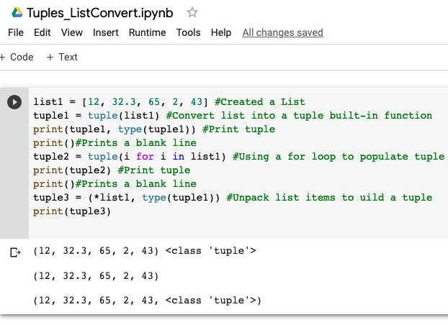
Converting to Tuples
Convert to Tuple
List to tuple.
Tuple function.
For loop.
Unpack list.
Notes:
Explain
Now that you have your tuple, what can you do with it?

Slide 6
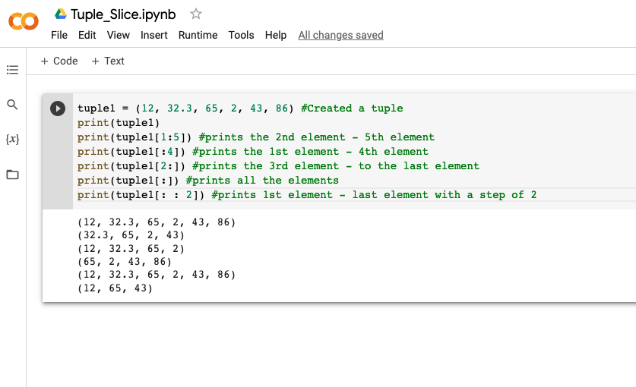
Slicing to Tuples
Slicing

Slide 7
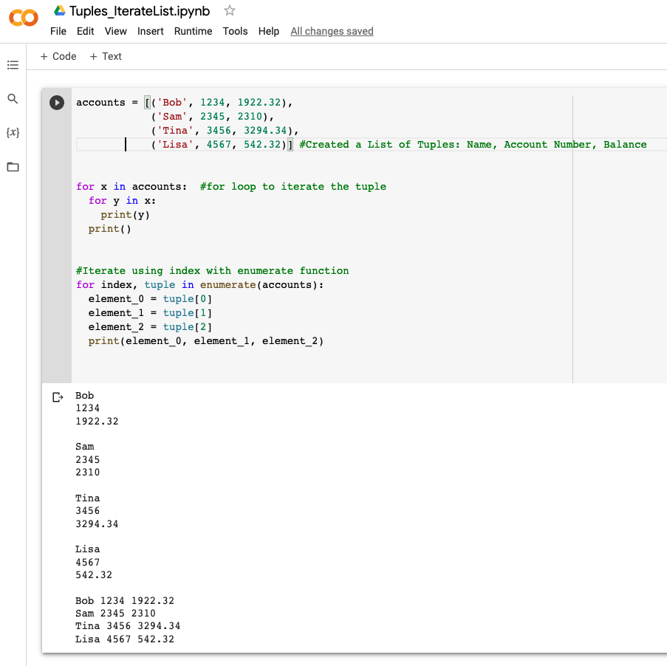
Iterating Through List of Tuples
Iterations
For loop.
Enumerate.
Notes:
Hope this gives you a basic understanding of how Tuples can be used to store your data. See you in the next video.

